Slide 1

Introduction Automotive Industry

Slide 2
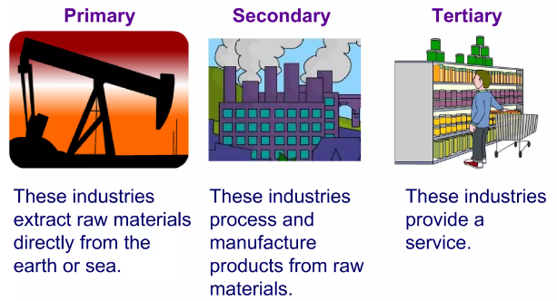
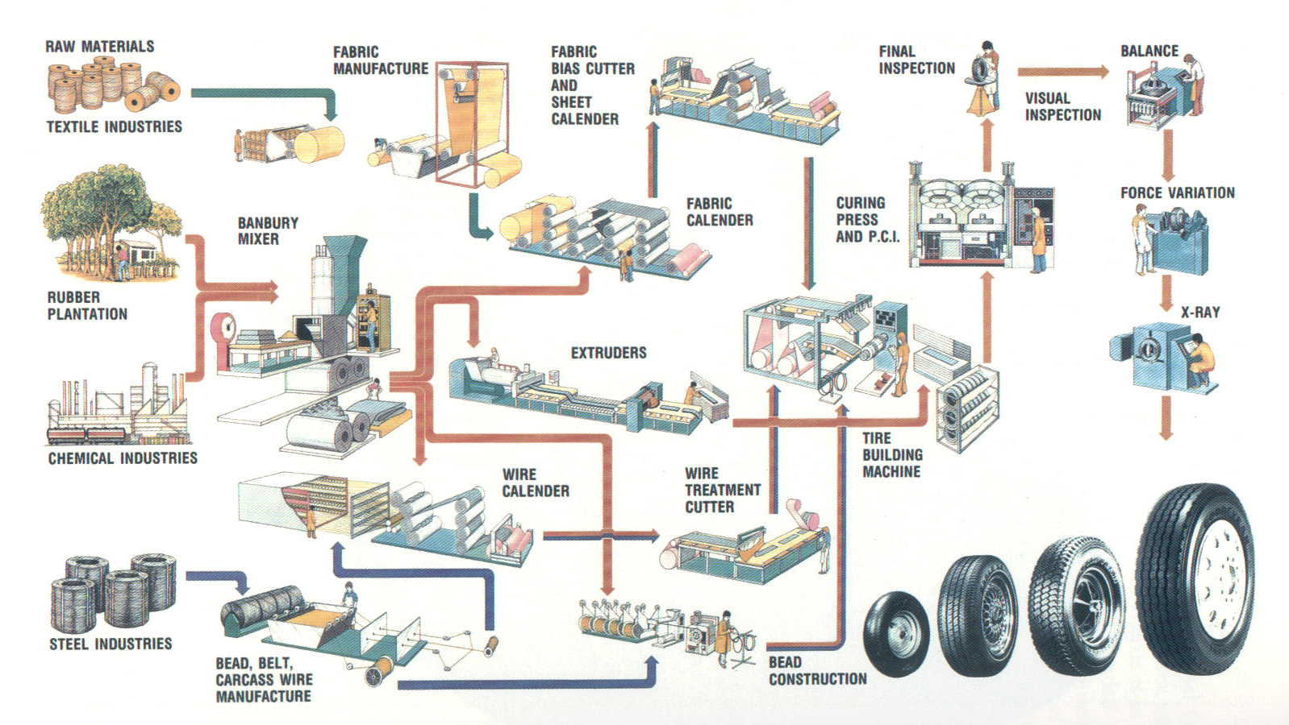
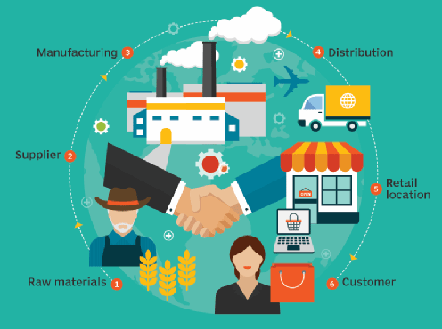
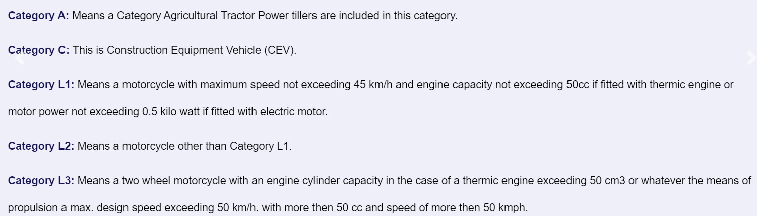
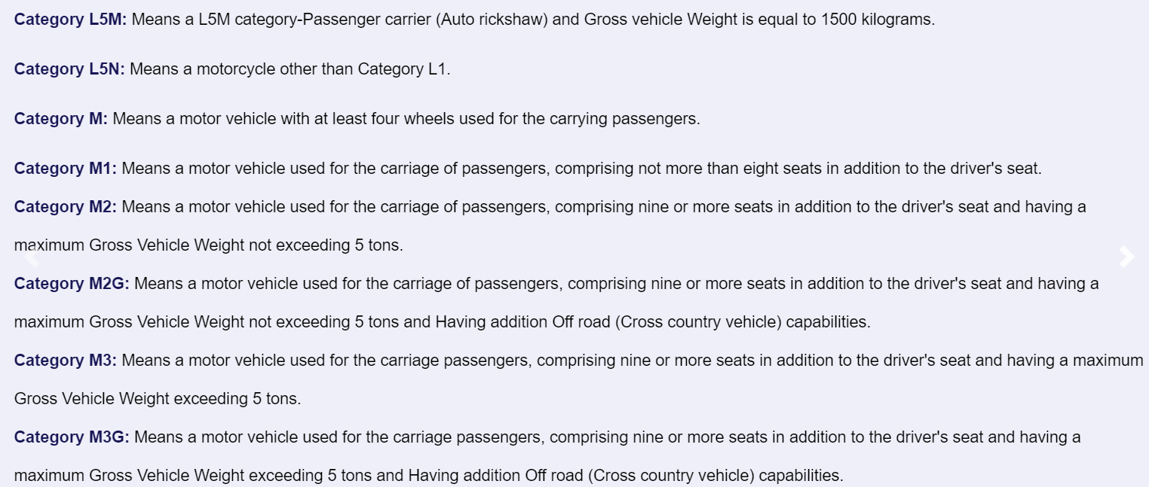
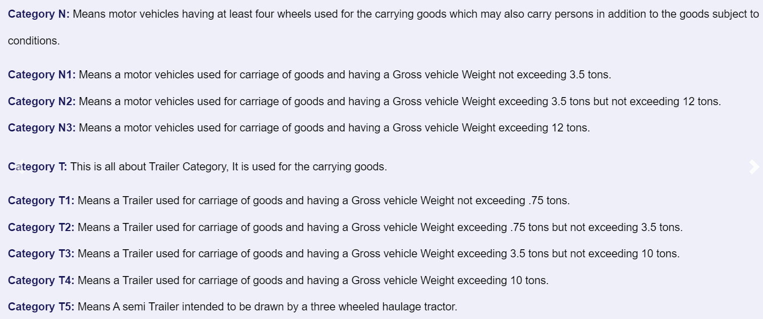
Industry
Manufacturing
Supply Chain
Automotive Industry
Vehicle Classification
https://vahan.parivahan.gov.in/makermodel/vahan/welcome.xhtml
https://en.wikipedia.org/wiki/Vehicle_category

Slide 3
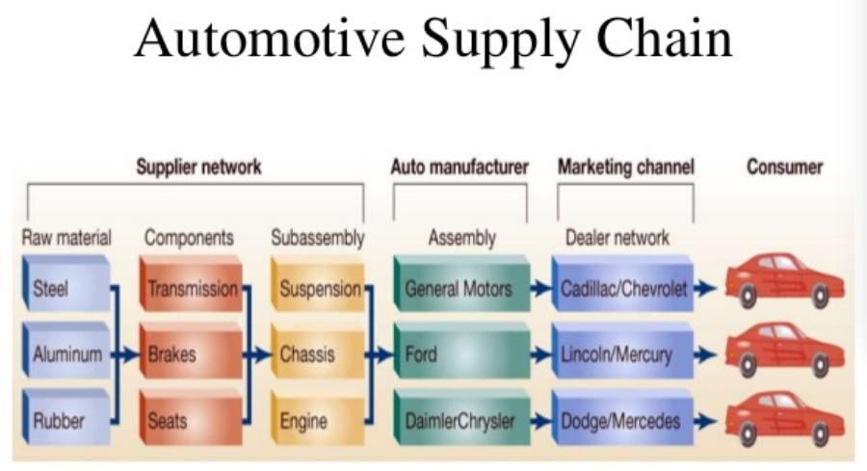
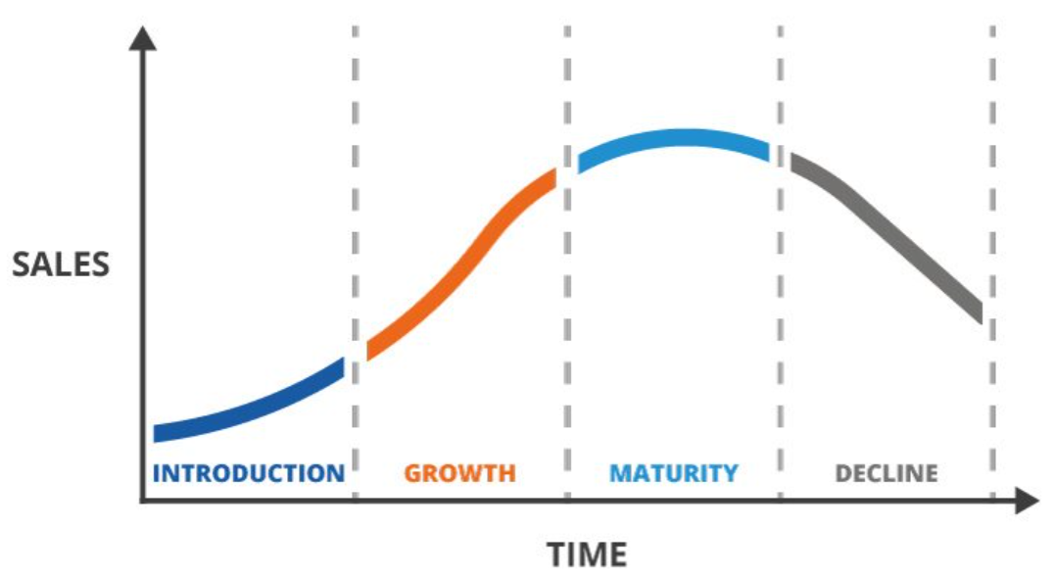
Automotive Supply Chain
Product Life Cycle
Bill Of Materials
Type :-
Static BOM
Dynamic BOM
Level:-
Single-Level
Multi-Level
Inventory
Raw materials
InProgress goods
Finished goods
Spare parts
Manufacturing Strategies
Customized to order
Make to order
Assembly to order
Make to stock
EBOM:- Engineering BOM is directly derived from CAD. Used for proto development. MBOM:- Manufacturing BOM -> Used in production
SBOM:- Sales BOM -> Spare parts and subassembly accessories.

Slide 4
Planning:-
Strategic Business Plan
Major goals & objective
Period is for about 2-10 years
Sales & Operation plan
Prepared every month
Production plan on a broad category
Master Production Scheduling
Plan for production of individual end items
Period is for 1 to 4 weeks
Material Requirement Plan
Plan for production and purchase of components used in making the end items in MPS
Plant Maintenance:-
Prevent breakdown of failure
Minimize production loss from failure
Increase reliability of the operating system
Type:-
Breakdown Maintenance
Scheduled Maintenance
Preventive maintenance
Predictive maintenance

Slide 5
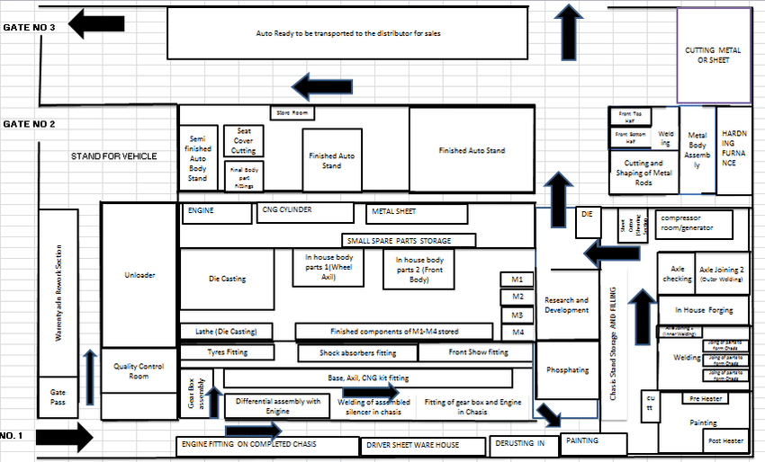
Function Layout

Slide 6
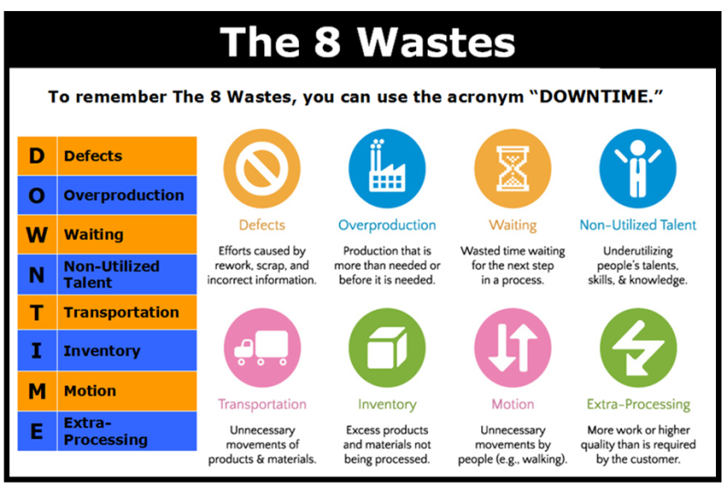
Quality
Conformance to specifications includes the activities from the suppliers, through production, and to the customers.
Objective
To achieve desired level of product quality and customer satisfaction
Minimize defects and reduce cost of quality by monitoring processes
Waste in operations

Slide 7

Customer Service
Service provide to customers before, during ,after purchasing and after using goods and service.
Call Center - Voice support for taking a remedial action for any defect.
Channel management - Customers are via multiple channels or touch points such as marketing via online, mobile, telephone etc.
Customer insight - Collection deployment and interpretation of information that allows a business to acquire, develop and retain the customers.
Technical Documentation - Every issue and its resolution must be documented for future usage.

Slide 8
Service Process
Gathering Product from customer
Estimating Cost
Allocate repair order
Perform the job
Informing on additional job
Assure Quality
Closing the job
Invoice and pay
Deliver the vehicle
Measure Satisfaction
Making Refunds
Survey on services
Warranty
It is a statement of assurance or undertaking issued by the manufacture of a product with regards to the performance for certain period.
Warranty claim process
Claim Registration
Claim Verification
Dispute Resolution
Claim Approval/Rejection
Claim Settlement
Warranty Clamming Conditions
Manufacturing Defect
Defect arising out of normal use
Supplier part defect
Damage during service/delivery

Slide 9

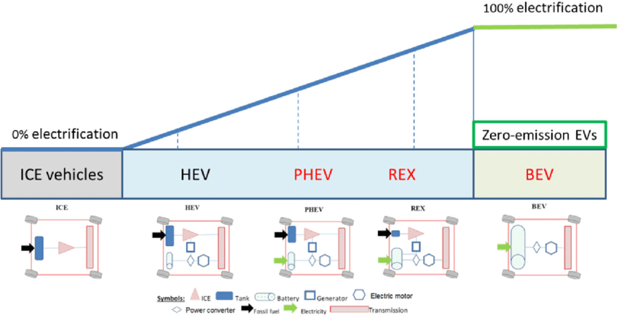
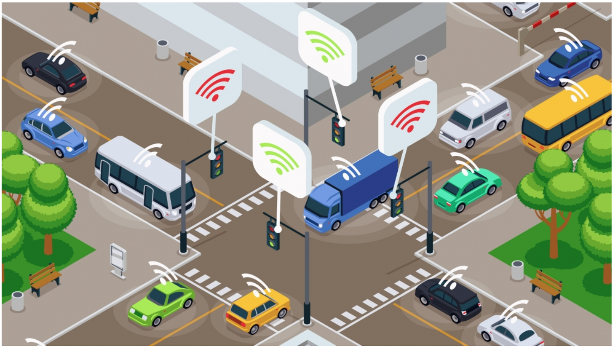
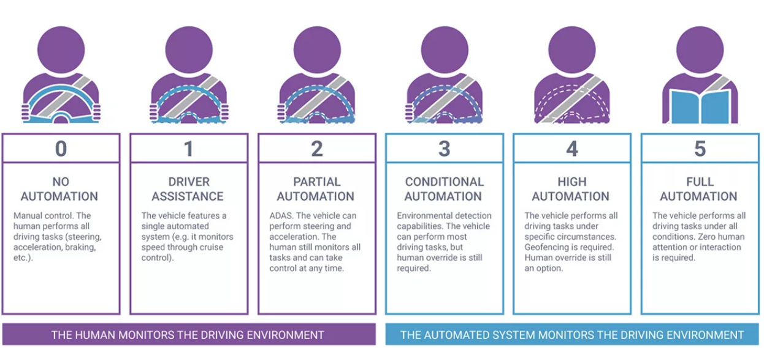
Electrification of Vehicle
Electrification of vehicle have major impact in automotive industry.
EV - lesser components -> less complex supply chain process flow.
Connected vehicle
Automation Level of Vehicle
https://www.sciencedirect.com/topics/social-sciences/connected-vehicle#:~:text=Connected%20Vehicles%20(CVs)%20are%20those,elements%20of%20the%20transport%20system.

Slide 10
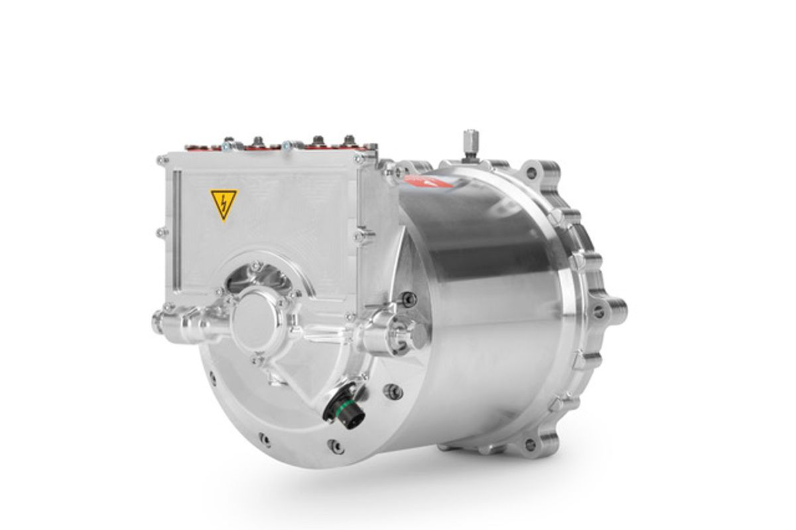
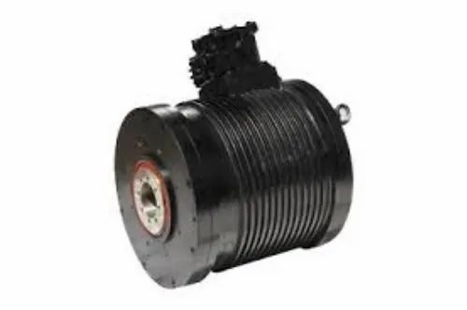

Which motor have higher efficiency??
A ) PMSM 5- 10 kW
B ) PMSM 100-250 kW

Slide 11
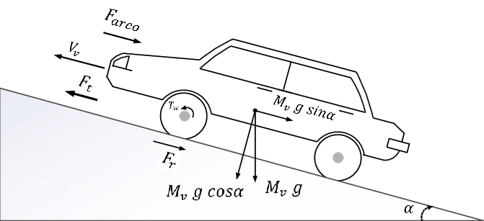
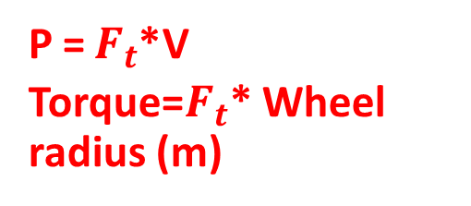
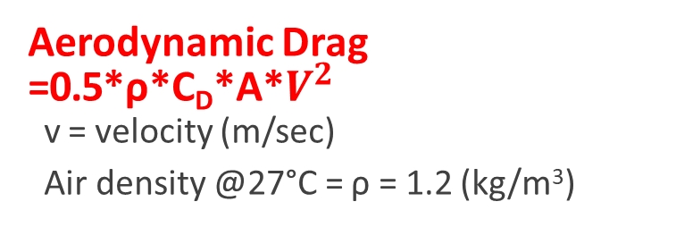
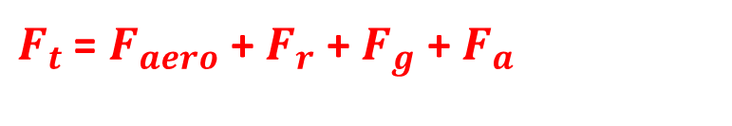


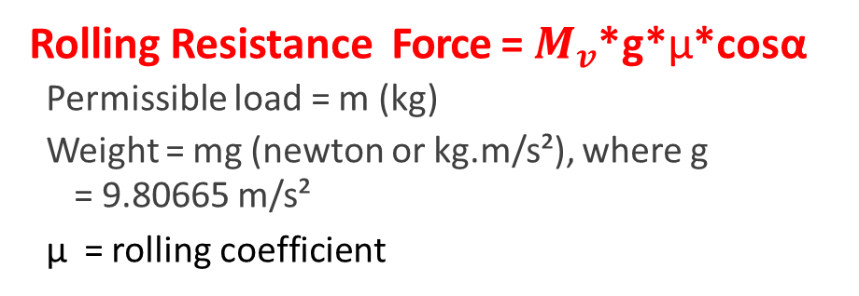
Overview ON VEHICLE DYANAMIC
Aerodynamic Drag =0.5*ρ*C_{D}*A*$V^{2}$
v = velocity (m/sec)
Air density @27°C = ρ = 1.2 (kg/m³)
P = $F_{t}$*V
Torque=$F_{t}$* Wheel radius (m)
Fa
Vehicle Frontal Area or Projected Area =A (sq. m)
Drag coefficient = CD
Rolling Resistance Force = $M_{v}$*g*μ*cosα
Permissible load = m (kg)
Weight = mg (newton or kg.m/s²), where g
= 9.80665 m/s²
μ = rolling coefficient
Typical values of Rolling Resistance
Aerodynamic Drag
Rolling Resistance force
Gradient Resistance force
Acceleration
Car tyre on smooth tarmac road:
Car tyre on concrete road :
Car tyre on a rolled gravel road:
Tar macadam road
Unpaved road
Bad earth tracks
Loose sand
Truck tyre (concrete/ asphalt)
Wheel on iron rail
0.01
0.011
0.02
0.025
0.05
0.16
0.15-0.3
0.006-0.01
0.001-0.002
Gradient Force = $M_{v}$*g*sinα
Maximum grade = α° = α*π/180 radians
Acceleration Force = $M_{v}$*a
$F_{t}$ = $F_{aero}$ + $F_{r}$+ $F_{g}$ + $F_{a}$

Slide 12
Match the inputs to the desired parameter/characteristics .
Motor max speed
1
1
Top Speed of vehicle
Motor Peak Efficiency
4
2
Max gradeability of vehicle @ X Kmph and duration
Max gradeability of Vehicle
Motor Peak Current
2
3
Max Acceleration of vehicle
DC Charging port
6
4
Continuous operation/drive cycle of vehicle
Motor Peak Power
3
5
Top speed duration
Battery Max discharge C rating / Current
2
6
Fast charging
Motor Peak Current duration
2
Motor thermal tolerance duration
5

Slide 13
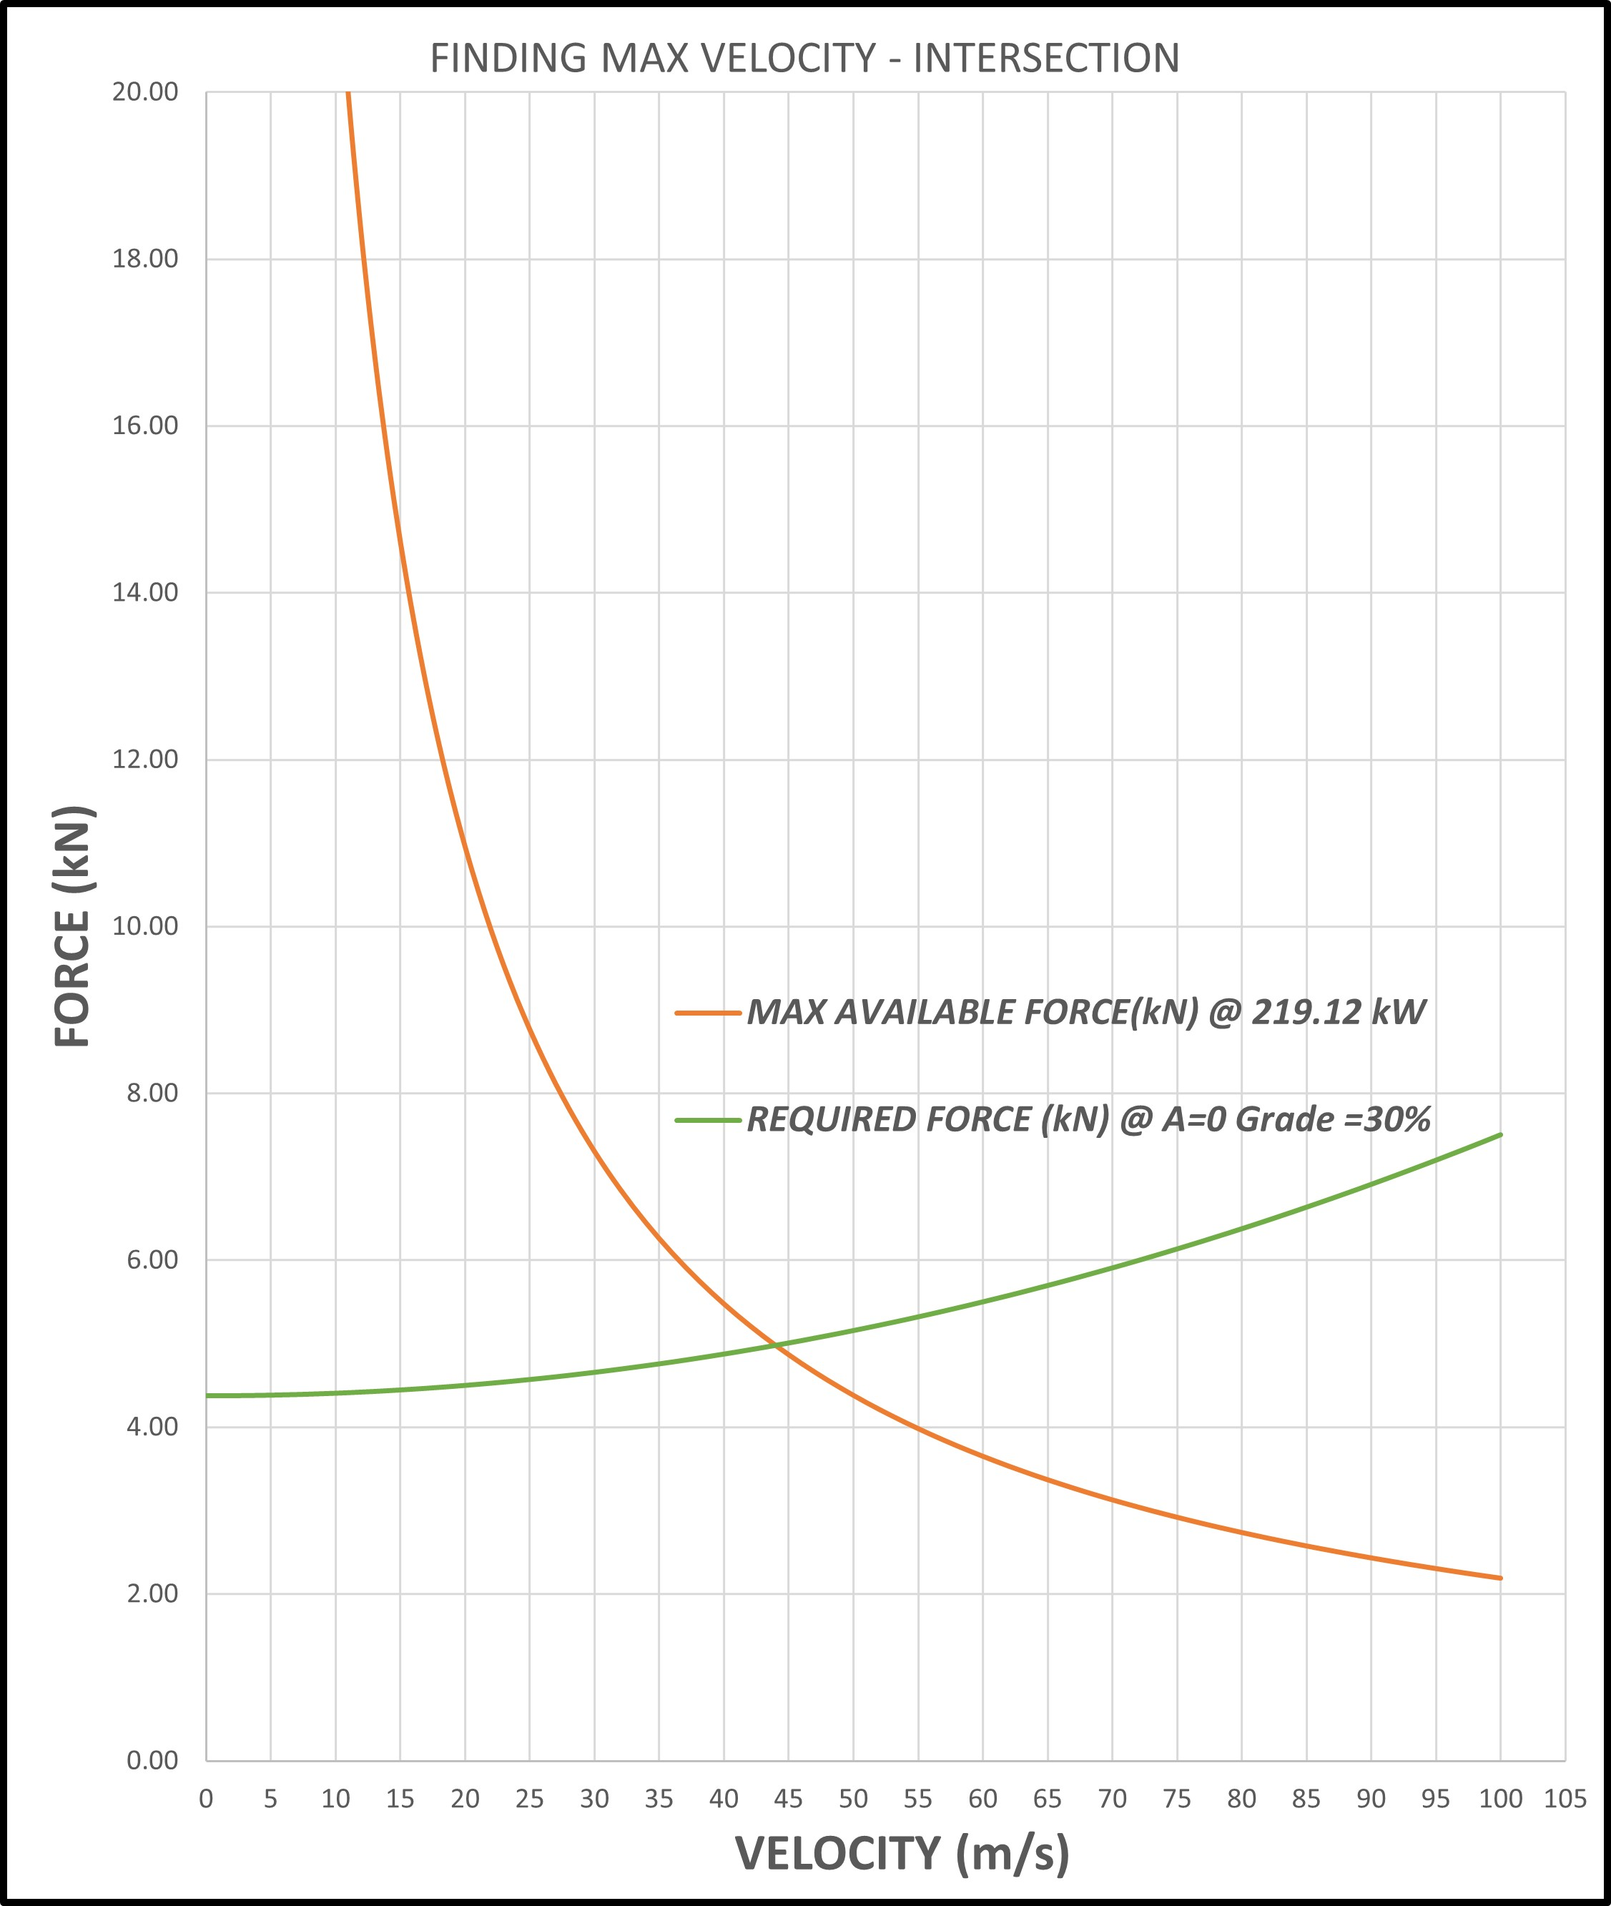
Bonus
Given the powertrain can supply the power according to the answer to question Q1.b. (219.18 kW), what is the maximum constant speed (m/s), at a road gradient G = 30%?
Method 1
Method 2
Hints
Pmax=Ft*V
=> Ft= Faero +Facc +Fg +Frr
given constant speed so Fa=0 N
=> 0.5*Cd*A*ρ*V^2 + m_veh*g*sin(theta) + m_veh*Cr*g*cos(theta)

Slide 14
Questions ?

